Slide 1
Java Basics
Session 2

Slide 2
Contents
Brief history of Java
Language fundamentals
Data types
Variables
Operators
Conditional Operators
Loops
Functions
Function Overloading
Arrays
Enhanced for loop

Slide 3
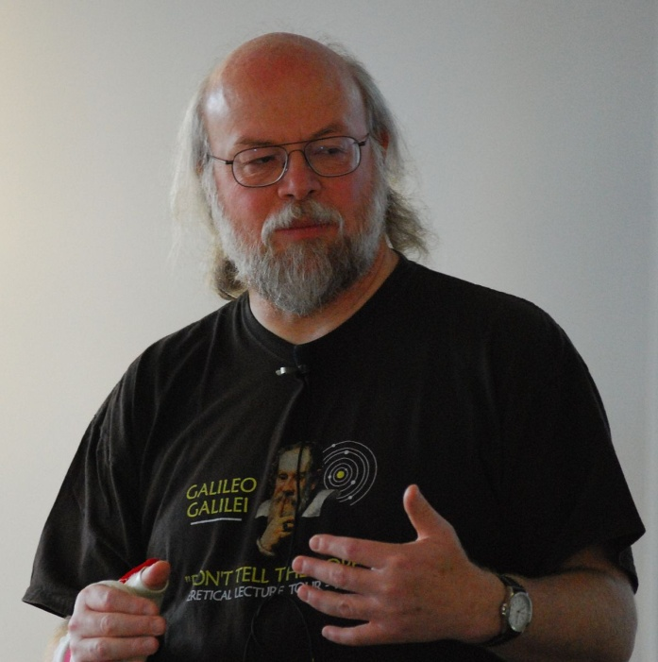
Brief History of Java
Invented by James Gosling at Sun Microsystems in May 1995.
Origin name was OOK later renamed as Java.

Slide 4
Features of Java
General Purpose
Class based
Object oriented
Platform Independent
Distributed
Portable (Flavors of Java)
  JSE
  JME
  JEE/J2E
Robust
Interpreted

Slide 5
Keywords
Keywords are certain reserved words which meaning is known to compiler.
Compiler is capable to work on them.
if, else, for, class, break, while, switch, case etc.

Slide 6
Identifier
Name given to user defined objects in the program like
  Variable
  Function
  Class
  Array
  Objects
  Package
  Project

Slide 7
Rules for Identifier
Contain combination of A-Z, a-z, 0-9 & _
Should not start with number.
Should not contain any special character and white space.
Styles
  Capitalize each word – AreaOfCircle, Shape (Class, Project & Package, Interface)
  Camel case – areaOfCircle (Methods, variables, object, array)
  Small case – areaofcircle
  Snake Case – area_of_circle

Slide 8
Variable
Variable is name of memory location where certain value is stored.
Variable is a container. Which stores some value
Name of variable
no1
100
Value
1000
Address

Slide 9
Data types
Data type is nothing but type of data stored in variable.
Integer – whole number - int
Decimal numbers – 3.142 – float
12345679.4563217 – double
Character – single character - char
String – collection of characters. – String
Boolean – Stores true / false

Slide 10
Types of Data Type
Primitive (Value Type)
  int, char, float, double, boolean
Non Primitive (Reference Type)
  String

Slide 11
int no1 = 10;
String name = “Amita”
Stack
Heap
no1
10
Name
1000
Amita

Slide 12
Variable Declaration & Definition
Declaration
  Syntax
  <data type> <name of variable>;
  int no1;
  char grade;
  float avg;
Definition / initialization
  Syntax
  <data type> <name> = <value>;
  int no1 = 8;
  float avg = 7.8;
  char ch = ‘T’;
  String name = “Amita”;
  boolean isSelected = true;

Slide 13
Operators
Operators are symbols which are used to perform some operations.
Operators
Unary
++, --, -, !
Binary
Ternary
Arithmetic
+, -, *, /, %
Conditional
<, >, <=, >=, ==, !=
Assignment
=, +=
?:
Logical
&&, ||

Slide 14
Operator, Operand & Expression
Operands
Statement / Expression
sum = no1 + 50;
Operator

Slide 15
Writing 1st Java Program
Folder
Select Workspace
Create Project
Package
Class (Program)

Slide 16
Basics of Java
Displaying something on console
System.out.println()
This is the function which is used to display some message on screen.
Eg.
System.out.println(“Hello Friends!!!”);
Workspace (Folder) → Project → Package → Class

Slide 17
Checking conditions
For checking any condition in Java, one can use several statements like
  if
  if – else
  nested if
  switch-case

Slide 18
Condition
True
Statements
False
Stop

Slide 19
if condition
if condition is one of the conditional statement in Java.
It is used to check a condition and executing or skipping some statements depending on condition.
Syntax
if(condition / expression)
{
Statement(s);
}

Slide 20
Condition
False
Statement/s
True
Statement/s
Exit

Slide 21
if – else statement
It is extension of simple if statement.
Syntax
if(Condition / Expression)
{
Statement(s);
}
else
{
statement(s);
}

Slide 22
< 1000 2%
>= 1000 & < 3000 5%
>= 3000 & < 5000 10%
>= 5000 15%

Slide 23
Nested if – else
Used when more then one condition is needs to be checked.
Syntax
if(condition)
{
statement(s);
}
else
{
if(condition)
{
statement(s);
}
else
{
statement(s);
}
}

Slide 24
Logical Operators
Condition 1 | Condition 2 | && Operator | || Operator
True | True | True | True
True | False | False | True
False | True | False | True
False | False | False | False

Slide 25
switch-case
Switch statement is used to choose one of several statements based on value.
Syntax
switch(variable)
{
case 1:
statement(s);
break;
case 2:
statement(s);
break;
default
statement(s);
}

Slide 26
Points to be noted about switch-case
switch-case selected one block of case from multiple blocks
default executes when any one of the case is not matched.
It works only on int or String values
case values need not to be in sequence
No duplicate case values are allowed.

Slide 27
Loops
When some of statements needs to repeatedly executed, one need to use loops.
Java supports 2 types of loops
  Pre-Tested loops
    for loop
    while loop
  Post-Tested loop
    do-while loop

Slide 28
while loop
Initialization
Syntax
while(condition)
{
statement(s);
}
Condition
False
Exit
True
Statements

Slide 29
for loop
Syntax
for(initilization;condition;increment)
{
statement(s);
}

Slide 30
do-while loop
Initialization
Statements
Syntax
do
{
statement(s);
}while(condition);
Statements in do-while loop executes at least once irrespective of it’s condition
True
Condition
False
Exit

Slide 31
Functions
Function is pre-defined block of statements which can be used / Executed n number of times.
Types of function
  Pre-Defined / In-built / Library Function
  User defined function
Parts of function
  Function definition / Body of function
  Function call

Slide 32
Function Overloading
These are functions with same name and different signature.
calAdd(int, int)
calAdd(int, int, int)
calAdd(double, double)
calAdd(double, int)
calAdd(int, double)
Function Signature
  No of arguments
  Data type of arguments
  Sequence of arguments

Slide 33
Array
Array is finite set of homogenous elements stored in continuous memory locations.
Arrays are known as First Class Objects in java.
Syntax:
<datatype> <arrayname>[]=new <datatype>[size];
Array Element is having unique, +ve, integer & Zero based Index No
marks[0]
marks[1]
Marks[2]
Marks[3]
Marks[4]

Slide 34
Enhanced for loop
for(<datatype> <variable> : <collection>)
{
Statement(s);
}

Slide 35
2 Dimensional array
[0][0] | 0 1 | 0 2
1 0 | 1 1 | 1 2
2 0 | 2 1 | 2 2
3 0 | 3 1 | 3 2

Slide 36


